Slide 1
Welcome to the Philly UserCon

Slide 2
PowerCLI 101 Getting Started with the Shell

Slide 3




Justin P. Sider
Chief Information Officer – Belay Technologies
https://belaytech.com
Personal Blog
https://invoke-automation.blog
GitHub
https://github.com/jpsider
Twitter (X)/Slack
jpsider
VMware Community
vExpert, VMUG Co-Leader, Code Coach, VMUG BOD

Slide 4
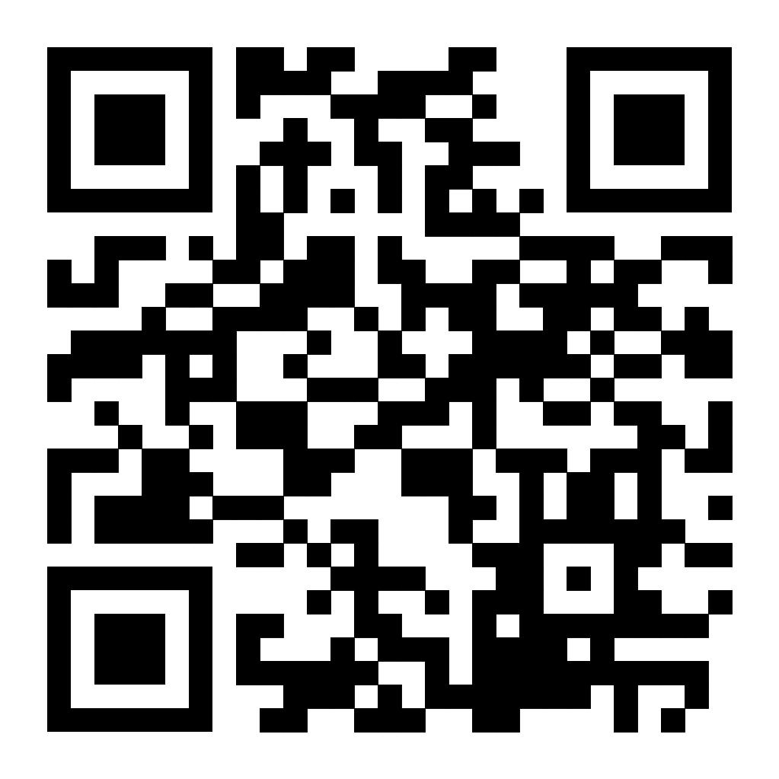
Agenda
Basic PowerShell Concepts
Installing PowerCLI
Connecting to a vCenter
Getting data from vCenter
PowerShell things
Toggling the PowerState
The Demo Environment
Live Demo & VMware code Website
Today’s Code and slide deck

Slide 5
Take Aways
PowerShell Basics
Installing & using PowerCLI
Resources
Today’s Code and slide deck

Slide 6

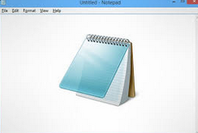
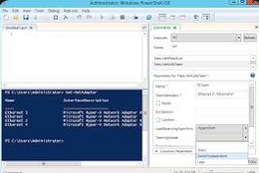


Code Editor (IDE)
Window Notepad
Notepad++
PowerShell ISE

Slide 7
Versions of PowerShell
Windows PowerShell 5.1 (and older)
Standard on Windows 10+
PowerShell Core 6
Introduced support for Linux (2016)
Containers
PowerShell 7 (2020)
Cross Platform
‘pwsh.exe’

Slide 8
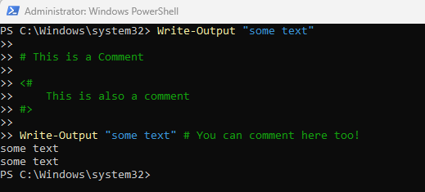
PowerShell Basics
Verb-Noun (Functions & Cmdlets)
Examples:
Get-Process
Write-Output
Approved Verbs
Get-Verb
Comments
#Comments

Slide 9
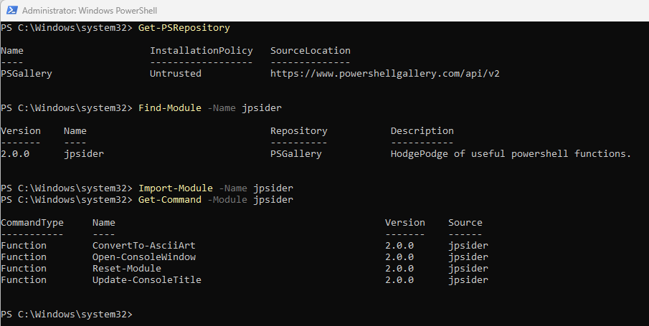
Installing PowerCLI
The PowerShell Gallery
Get-PSRepository
Find-Module –Name VMware.PowerCLI
Install-Module –Name VMware.PowerCLI
Import-Module –Name VMware.PowerCLI
Get-Command –Module jpsider
Save-Module –Name jpsider –Path c:\temp

Slide 10
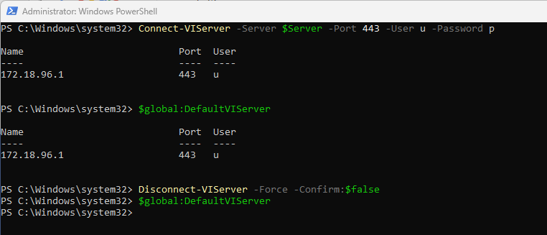
Connect to a vCenter
Commands:
Connect-VIServer –name myvcenter –Username “administrator” –Password “VMware1!”
$global:DefaultVIServer
Disconnect-VIServer –Force –Confirm:$false

Slide 11
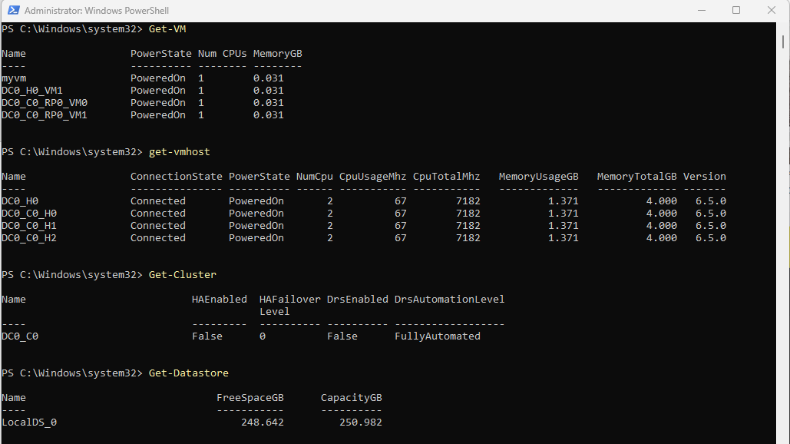
Getting Data from vCenter
Verb-Noun
Get-VM
Get-Vmhost
Get-Cluster
Get-Datastore
Many Many more!

Slide 12
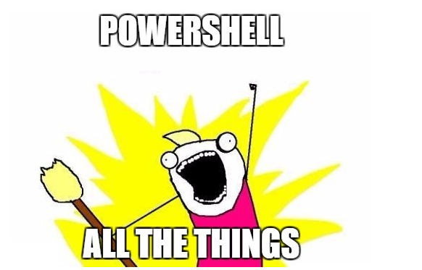
PowerShell Things
Functions & Parameters
Objects
Pipeline
Comment Based Help

Slide 13

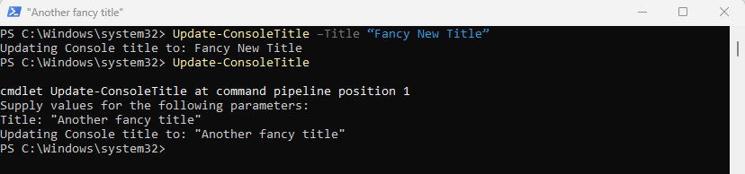

Functions & Parameters
<Function Name> <Parameter name> <Parameter Value>
Get-VM -Name “myvm”
<Function Name> <Parameter name> <Parameter Value>
Update-ConsoleTitle –Title “Fancy New Title”
If a Parameter is required – PowerShell will ask you for it!
We talkin’ about Practice Parameters, Man.

Slide 14

Objects
A collection of Data that represents an Item.
In PowerShell and Object is made up of 3 types of Data
Object Type
What am I?
Methods
What can you do to me?
Properties
What are the things that describe me?
Get-Member
$vm = Get-VM "myvm"
Get-Member -InputObject $vm
Get-Member –InputObject (Get-VM “myvm” | Get-View)

Slide 15
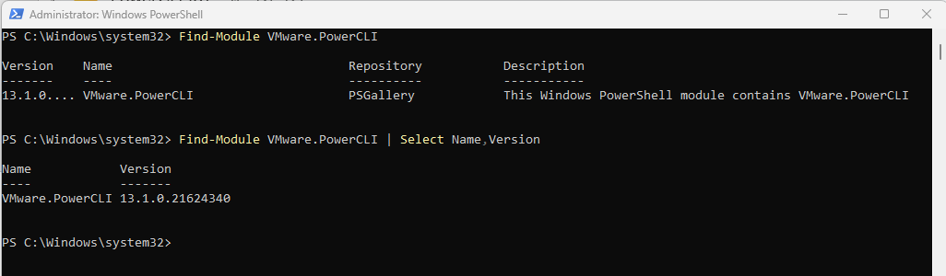
The PowerShell Pipeline
The PowerShell pipeline allows you to chain together commands to build a single ‘pipeline’ which simplifies code and allows parallel processing.
Get-VM | Select-Object –Property Name
Get-VM | Where-Object {$_.Name –like “*myvm*”}
Find-Module –Name VMware.PowerCLI
Find-Module –Name VMware.PowerCLI | Select-Object Name,Version
The input to a command must accept the output of the previous command.

Slide 16
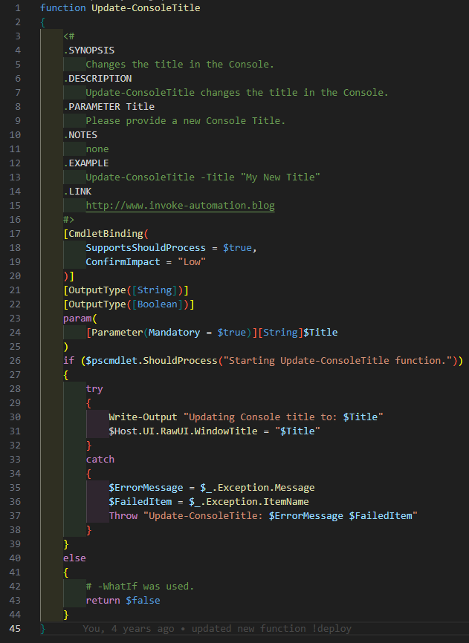

Comment Based Help
Get-Help Get-VM –Full
Get-Help Update-ConsoleTitle -Full

Slide 17

What Just Happened?
Takeaways from the Takeaways
Know your Objects
Get-Member
Call A Plumber
The Pipeline
See a Therapist
Get-Help
PowerCLI Detailed object details
Get-View

Slide 18
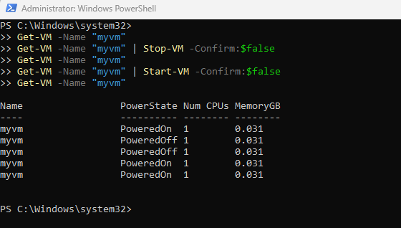
Toggling a VM’s PowerState
Get-VM -Name "myvm"
Get-VM -Name "myvm" | Stop-VM -Confirm:$false
Get-VM -Name "myvm" | Start-VM -Confirm:$false
Get-VM -Name "myvm"

Slide 19
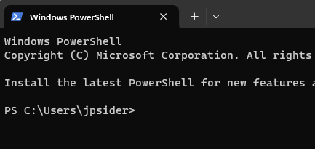

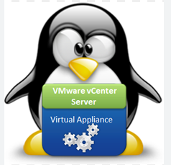

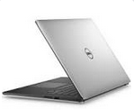
Demo Time

Slide 20
Resources
Developer Documentation:
https://developer.broadcom.com/
VMware Forums
https://community.broadcom.com/home
ChatGPT
Yes, AI can help you write PowerCLI code!
Today’s Code and slide deck

